Slide 1
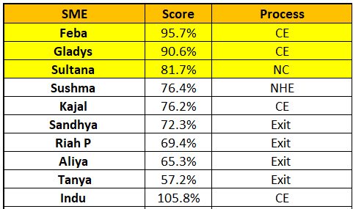
OVERALL BEST SME
Mar’23
Scoring methodology:
Parameters considered are:
% of team achieving all KRAs
Adherence/Productivity
Quality performance
Controllable & Red flag (for Exits)
Interventions & LinkedIn (for CE)
Weightage is assigned to each parameter
Score calculated for actual performance achieved

Slide 2



AceNgage
Dec’22 Performance Awards
AceNgage
Mar’23
Performance Awards

Slide 3

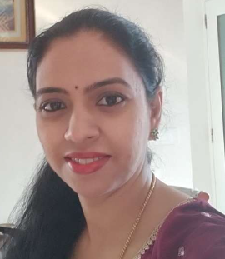


ACE PERFORMER
Chaya does it yet again! 4th month in a row – she has bagged this prestigious award with her dedication, hardwork and focus. No number is too big or too small for this dynamic woman!
A star performer in every sense of the word – Chaya has achieved these numbers every month keeping her quality and controllable targets too in mind. Having you on the team is a huge inspiration for everyone else.
It has been a pleasure to work with you, and we look forward to seeing you achieve many more milestones!
CHAYA RAMESH
Digital Certificate and
Gift voucher

Slide 4
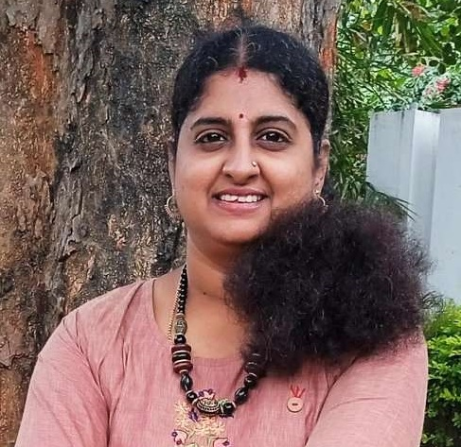
QUALITY PERFORMER
A winning smile and a great attitude – that’s Swati for you! One of our most resolute counsellors, Swathi has excelled every month when it comes to quality.
Thank you for being someone we can always count on. We are thankful for all your hard work!
Keep being the awesome Team Player that you are! Keep Shining!
Quality – 83%
SWATHI M G
Digital Certificate and
Gift voucher

Slide 5
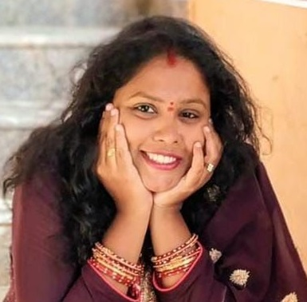
QUALITY PERFORMER
One of our strongest Engagement Specialists, Priyanka is always on track and never needs a reminder nor a follow-up. She is consistent in maintaining her targets. Takes ownership and drives the team meticulously.
A diligent worker who has proved her capability, Priyanka has also received special mention from her clients for her excellent work.
Proud to have you in our Team and a part of the AceNgage Family, Priyanka Kumar!
Well deserved!
Quality – 81%
PRIYANKA KUMAR
Digital Certificate and
Gift voucher

Slide 6
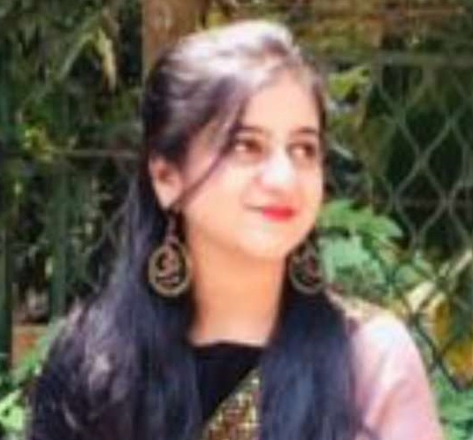
QUALITY PERFORMER
You have consistently worked hard to maintain your quality parameters. Not just your KRA’s you take ownership for the team too.
You are always available for them. We highly appreciate the way you take up responsibilities and complete them on time!!
All the best for many more successes.
Well done Saniya!
Quality – 79%
SANIYA AFREEN
Digital Certificate and
Gift voucher

Slide 7
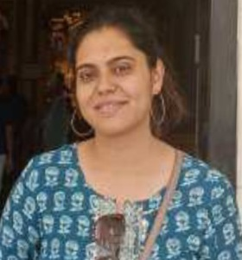
MOST IMPROVED PERFORMER
Thank you for inspiring and supporting the team with your dedication towards work.
Your performance has improved, and we are delighted! Adherence-101%, Quality-78%, C%-62%, Red flag-3%
Thank you for an excellent job last month!
Good Job!
RASHU SINGH
Digital Certificate and
Gift voucher

Slide 8

MOST IMPROVED PERFORMER
Proud to see the efforts you are giving in to improve overall quality month on month.
Hitting 80% quality, adherence at 108% is really and raising REDFLAG at 8% for month of March is spot on! Kudos to your efforts and cheers to many more success!
Keep up the spirit, Well Done and all the best for many more successes!
Good Job!
POOJA MISHRA
Digital Certificate and
Gift voucher

Slide 9

MOST IMPROVED PERFORMER
Taniya Tahreen indeed an inspiration to the whole team. She is consistent and excels in all her parameters.
Her hard work is evident in her quality and productivity.
Excellent improvement over the last 3 months and we wish you continue to stay on track with your stellar performance.
Good Job!
TANIYA TAHREEN
Digital Certificate and
Gift voucher

Slide 10
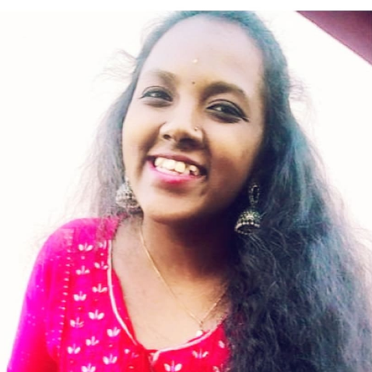
PAT ON THE BACK
Thank you for always being willing to jump on calls last minute to help our clients! When there was a need to do a quick fix for all the interviews that were taken, you did not say a NO.
Your attitude to do “whatever it takes” helped us close the client reporting on time. You did an amazing job handling everything calmly with a smile, keeping things organized and pulling everything together to ensure the client deliverables are met!
This to us is ownership! Well done:)
Good Job indeed!
KAVINI
Digital Certificate and
Gift voucher

Slide 11
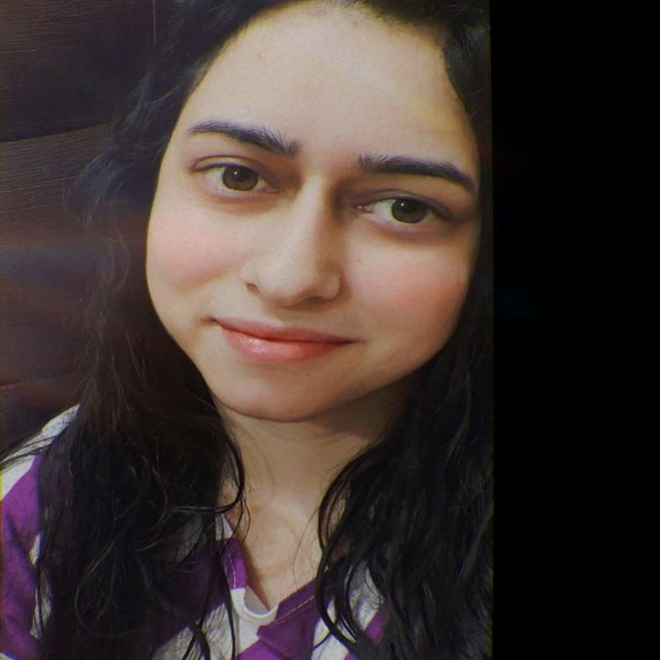
PAT ON THE BACK
Thanks for always being there when we need a helping hand and for everything you do. Your support has been genuinely appreciated and look forward to more collaboration!
Your performance graph has seen a major spike and keep flying higher! You deserve this Pat - on the back for superior performance and maximum no of interviews.
She definitely deserve a pat on the back!
NAVNEET KAUR
Digital Certificate and
Gift voucher

Slide 12

PAT ON THE BACK
She is a great asset to ‘Team Sandhya 'with her focused and disciplined approach to work. What is more remarkable about her is that she has been achieving all her KRAs benchmark consistently from the start which is quite amazing!
Moreover, she willingly travelled to a client location 3 days in a row to help the outstation team with their training workshop.
Your efforts are appreciated, and you ended March with a very impressive performance - Adherence 132%, quality 79%, C% - 56% and REDFLAG at 6%.
We are proud of you for the work that you do!
HEMANI SHAH
Digital Certificate and
Gift voucher

Slide 13
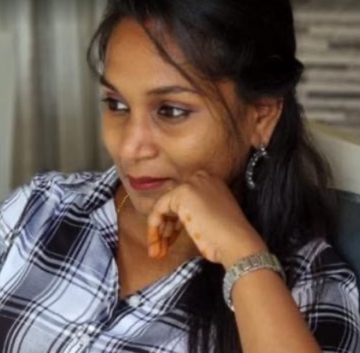
PAT ON THE BACK
One of the strongest pillars in CE and with the client ‘Carelon’, she has been consistent throughout her journey and is always looking to outshine herself.
Lakshmi’s cheerful and positive nature is one of her best attributes.
Always willing to lend a hand and support her SME she is one of the most reliable resources and a true team TREASURE!
LAKSHMI THANUJA
Digital Certificate and
Gift voucher

Slide 14
WINNERS LIST
CHAYA RAMESH
SWATHI M G
PRIYANKA KUMAR
SANIYA AFREEN
RASHU SINGH
POOJA MISHRA
TANIYA TAHREEN
KAVINI
NAVNEET KAUR
HEMANI SHAH
LAKSMHI THANUJA

Slide 15
Well Done to the winners… – …Good Luck for Apr’23

